Slide 1
The architecture of Wavenet

Slide 2
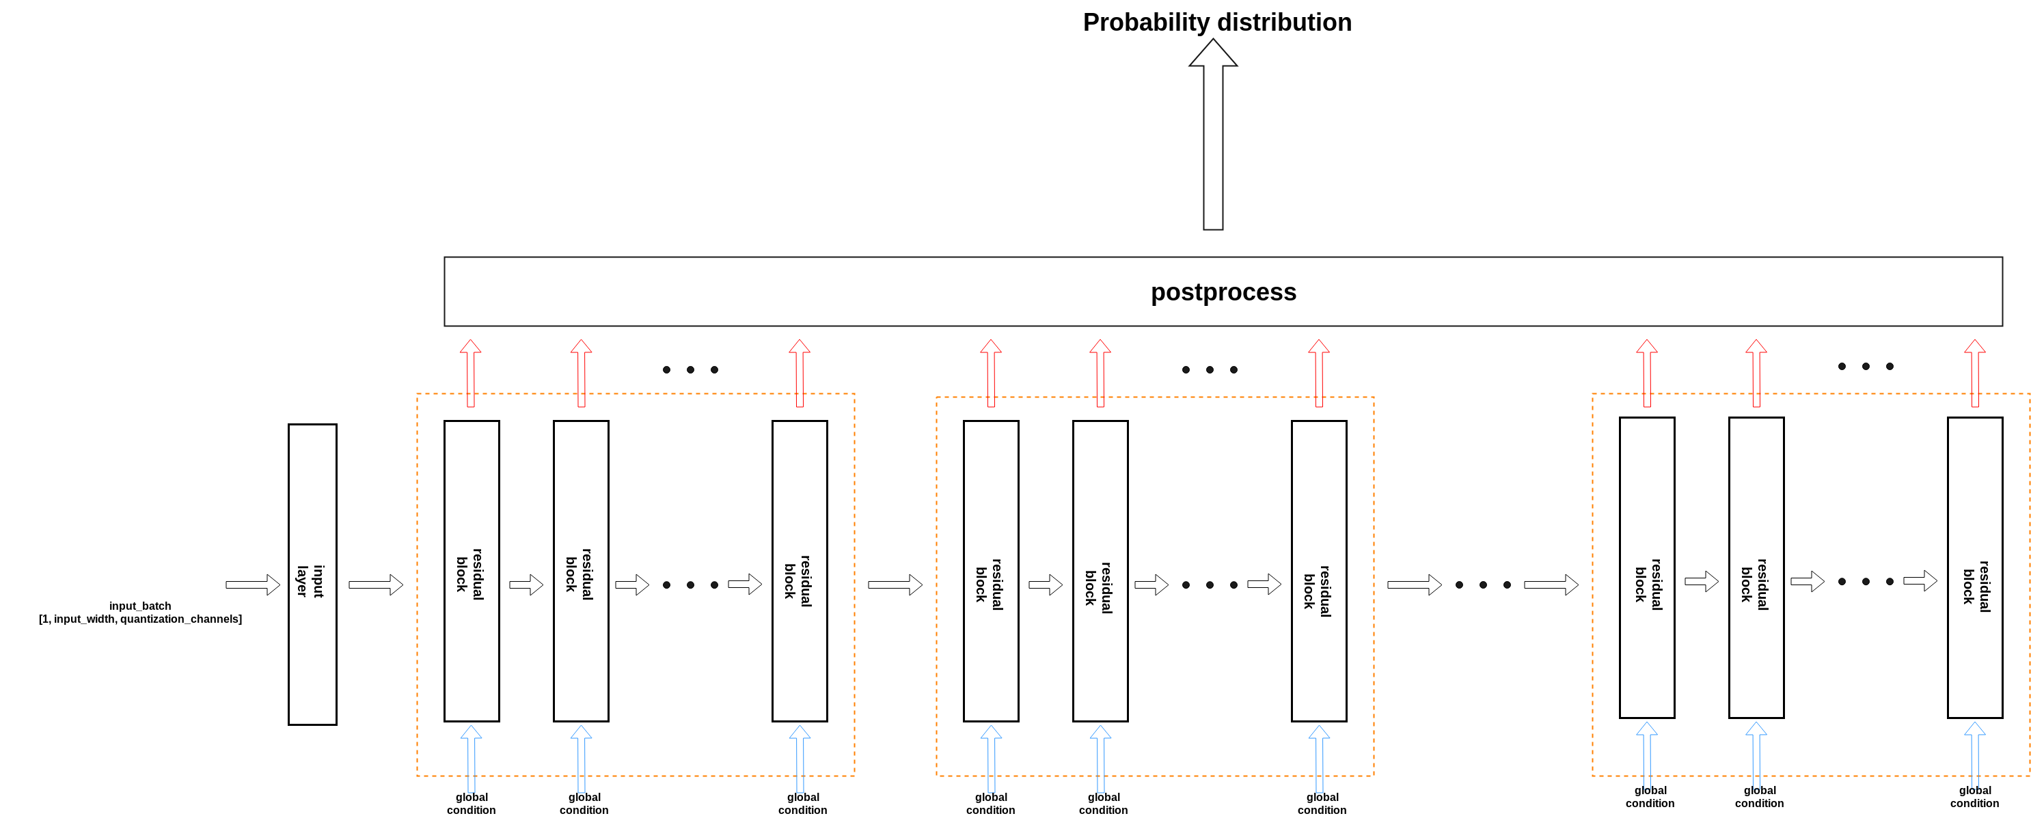
Overview

Slide 3
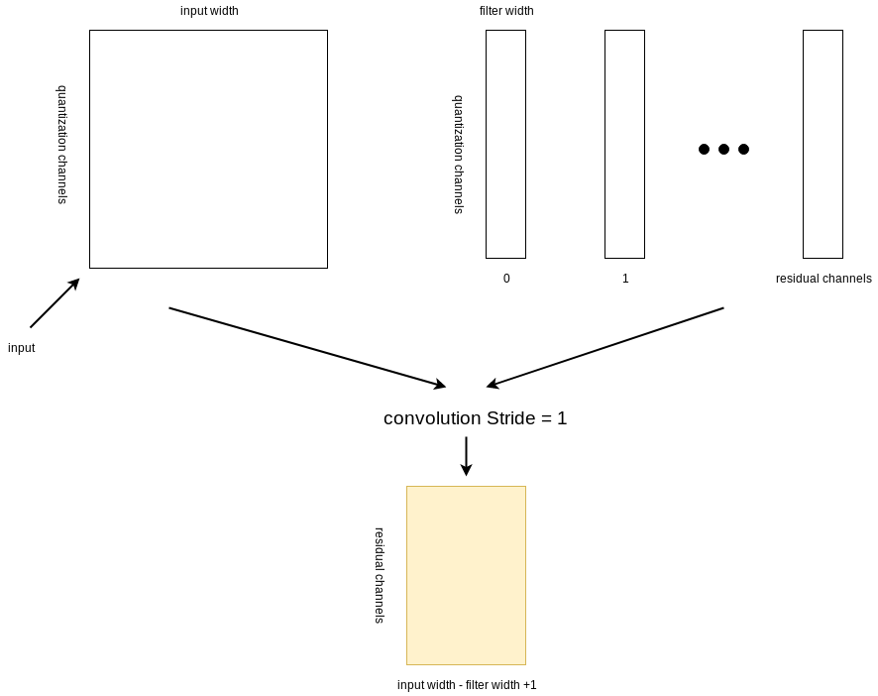
Input layer

Slide 4
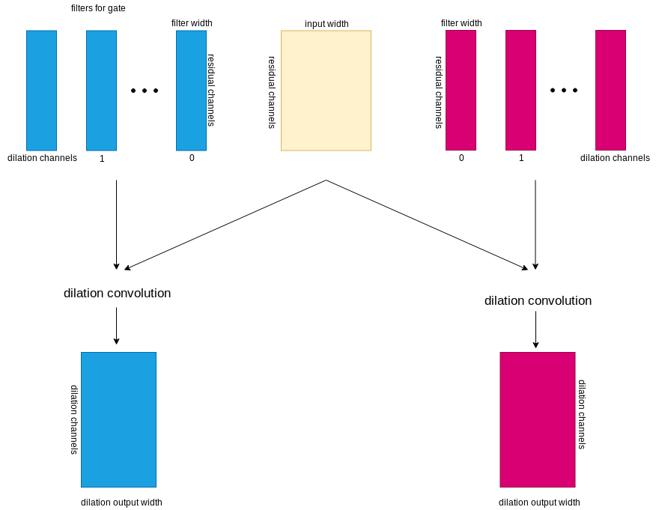
Residual Block
Dilation output width = input width – (filter width - 1) * dilation

Slide 5
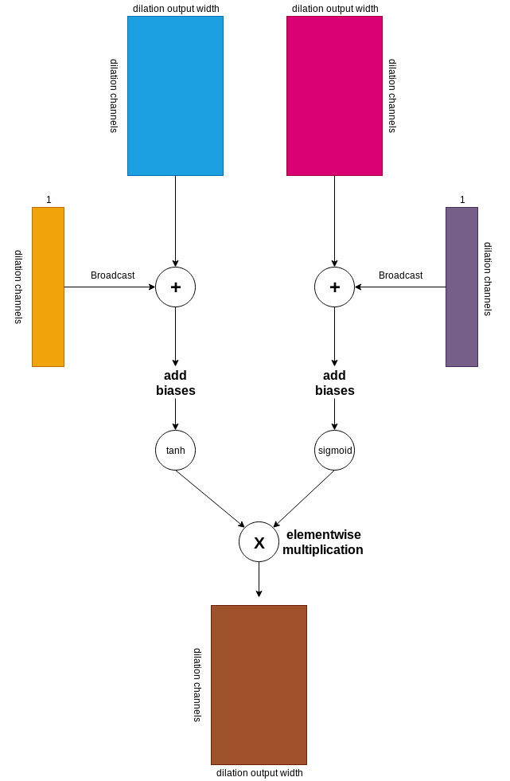
Residual Block

Slide 6
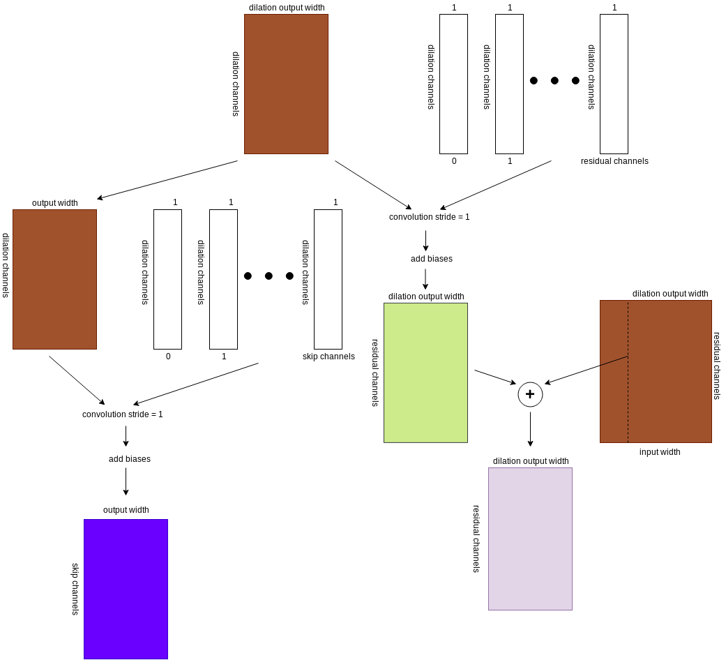
Residual Block
output width = input width – receptive field + 1
receptive field = (filter_width - 1) * sum(dilations) + 1 +
filter width -1

Slide 7
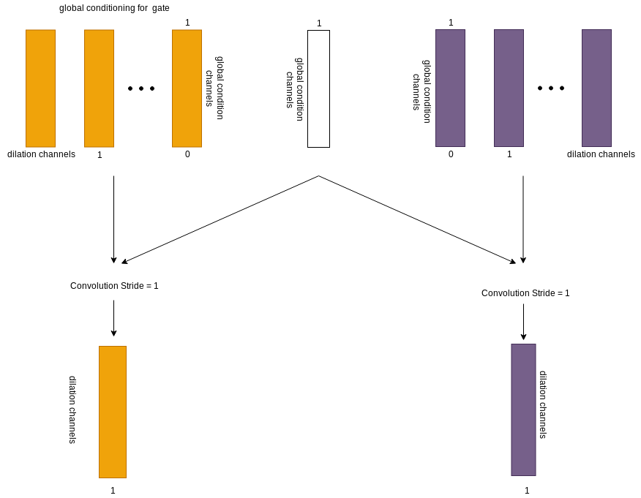
Global Conditioning

Slide 8
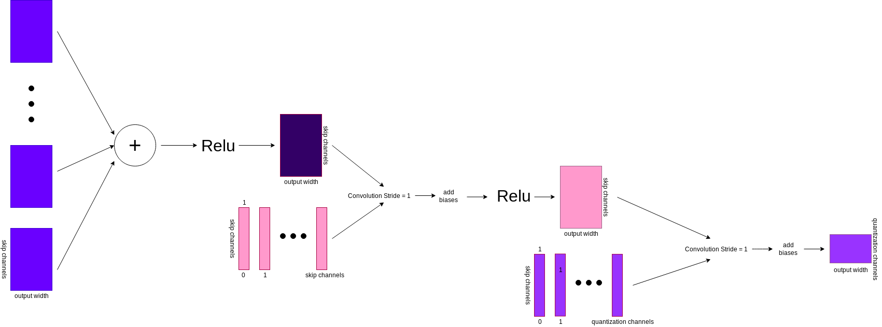
Postprocess

Slide 9
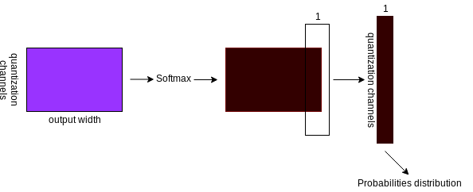
Postprocess

